Slide 1

VanderWey, S.
Building Successful Learning Communities Workshop
presented at
Global 4-H Network Summit
Ottawa, Ontario, CA
July 11, 2017
Notes:
1
Scott…

Slide 2
Human Bingo
Activity Directions:
Ask the questions.
Get only one signature per person.
Don’t sign your own.
Have fun.
Notes:
All

Slide 3

Building
Successful
Learning
Communities
Notes:
Scott

Slide 4


Introductions
Scott VanderWey
  WSU Faculty
  Director of 4-H Adventure Education
Audience
Notes:
4
Scott…

Slide 5
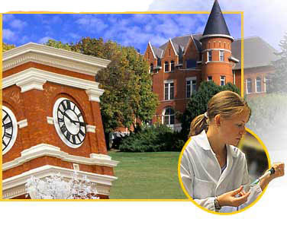
A Land Grant Research University
Notes:
Scott

Slide 6


Slide 7
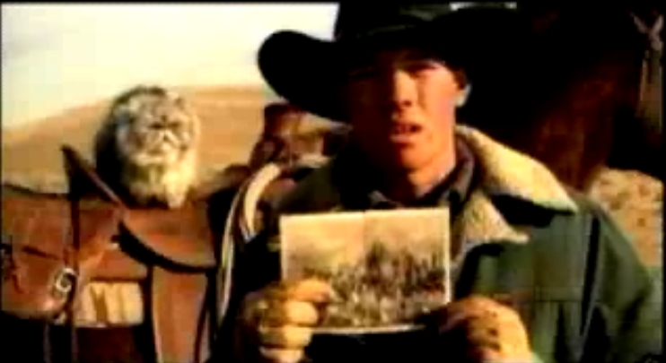
Cat Herding
7
How does this relate to you personally or professionally?
Notes:
Scott

Slide 8
Talking Object
Activity Directions:
Use the object as the device
to let every one know
whose turn it is to talk!

Slide 9
Re-grouping Strategies
Notes:
9
cody
90 sec. Warning
Survey Says
Hands-Up
Hokus Pocus… Focus
1, 2, 3 Eyes on Me
Quiet Coyote
Rhythmic Clapping

Slide 10
Check-In
Activity Directions:
Find a partner.
Introduce yourself.
Share with each other.
Notes:
Move to the back of the room , find a partner and get back to back.
We’re going to build our life skills by practicing our Active Listening Skills as we listen to our partner’s response.
Thirty sec. warning…
Find a different partner… and silently get back to back.

Slide 11
Active Listening
Eye Contact
Body Language
Focus
Follow-Up Questions

Slide 12
Check-In
Activity Directions:
Find a partner
Turn and introduce yourself
Share with your partner:
A highlight from
this 4-H year ...
12
Notes:
Move to the back of the room , find a partner and get back to back.
We’re going to build our life skills by practicing our Active Listening Skills as we listen to our partner’s response.
Thirty sec. warning…
Find a different partner… and silently get back to back.

Slide 13
Expressing Gratitude
Shake hands
Make eye contact
Thank them for sharing
Find a new partner

Slide 14
Check-In
Activity Directions:
Find a new partner
Turn and introduce yourself
Share with your partner:
One gift you
bring to teaching…
14

Slide 15
Expressing Gratitude
Shake hands
Make eye contact
Thank them for sharing

Slide 16
Workshop Norms
Be Here
Be Open
Be Caring
Have Fun
Notes:
16
Cody

Slide 17
Learning Targets
By the end of the workshop
you will be able to…
  Identify what the basic elements of a Learning Community are.
  Explain why Learning Communities are important.
  Understand how to use tools and strategies to create a Learning Community.

Slide 18
Continued
We also hope that you…
  Leave with a new paradigm
  and want to learn more!
Notes:
Scott

Slide 19
Shifting Paradigms
Old Paradigm
New Paradigm
Instructor
Facilitator
Rules
Norms
Discipline
Opportunities
React
Respond
Rote Learning
Relevant Learning
Product
Process
Curriculum Driven
Relationship Driven
Notes:
Cody

Slide 20
Creating Second Order Change
2nd Order Change
Values/ Beliefs
Vision
Trust
Action Plan
Skills
Resources
Payoff
=
Values/ Beliefs
Vision
Trust
Action Plan
Skills
Resources
Payoff
=
Sporadic Change
Anger
Values/ Beliefs
Vision
Trust
Action Plan
Skills
Resources
Payoff
=
Anxiety
Values/ Beliefs
Vision
Trust
Action Plan
Skills
Resources
Payoff
=
Values/ Beliefs
Vision
Trust
Action Plan
Skills
Resources
Payoff
=
False Start
Values/ Beliefs
Vision
Trust
Action Plan
Skills
Resources
Payoff
=
Sabotage
Values/ Beliefs
Vision
Trust
Action Plan
Skills
Resources
Payoff
=
Confusion
Values/ Beliefs
Vision
Trust
Action Plan
Skills
Resources
Payoff
=
1st Order Change
Notes:
20
Scott

Slide 21

What is a
Learning Community?

Slide 22
“The most promising strategy for sustained school improvement is developing the ability to function as a Learning Community.”
    Richard DeFour
    (Learning Communities at Work)
Notes:
If PLCs works at the staff level… what would it mean if students collaborated at the classroom level?
PLC #1- What it is it that I am suppose to learn? (Shared Purpose = Learning Targets)
PLC #2- How will I know if I learned it? (Shared Outcomes = Rubrics)
PLC #3-
PLC #4-

Slide 23
Think-Pair-Share
Consider:
What is a Learning Community?
How are Learning Communities
created?
Directions:
Think to yourself.
Discuss with a partner.
Share with your group.
23

Slide 24
Defining Learning Community
A Learning Community is…
Any group of people that comes together with the intent to learn!

Slide 25
Defining Community
Community is…
people who belong to a group;
with a common purpose;
with formal or informal rules or
behavior expectations;
with common interests or abilities;
working towards a common goal

Slide 26
Defining Community
Community is…
  Shared Membership
  Shared Purpose
  Shared Norms
  Shared Skills
  Shared Outcomes

Slide 27

Learning Community Model
Individual &
Group Success
Relationships, Relevance, & Rigor
Shared Memberships
Shared Purpose
Shared Norms
Shared Outcomes
Shared Skills
Experiences
Notes:
27
Scott

Slide 28
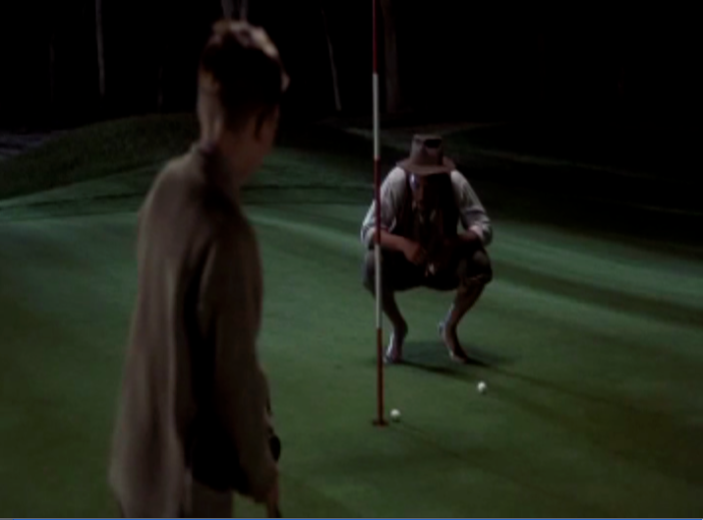
The Legend of Bagger Vance
Notes:
28
Scott

Slide 29
Discussion Circles
Activity Directions:
The person with the knot will be the speaker-- Everyone else will be practicing Active Listening.
Reflect and share:
  Why was Bagger Vance such an effective educator?
  How can you find your authentic swing in teaching?
Notes:
Natalie

Slide 30
Why Build Successful Learning Communities?
Notes:
Scott

Slide 31
  Powerful Teaching and Learning Through the Lens of
Rigor, Reflection, Relevance, and Relationships
Rigor
  Skills and/ or Knowledge are manifested as students develop conceptual understanding, not just recall.
Refection
  Thinking is evident because teachers provide opportunities for students to respond to open-ended questions, explain their thinking process, and reflect to create personal meaning.
Relevance
  Application of skills, knowledge, and thinking in relevant and/or real-world contexts is essential for engaging students in their learning and for helping students make connections that lead to understanding.
Relationships
  Relationships are positive and are essential for establishing optimal conditions for learning and include high expectations around challenging work, student social support for learning, and differentiation of instruction based on student needs.

Slide 32
What Impacts Learning?
Psychology and Educational Practice, Herber Walberg (2002)
Notes:
Scott

Slide 33
The prevalence and consequences of Adverse Childhood Experiences (ACEs) and toxic stress have harmful effects to health later on in life.
Notes:
33
Scott…

Slide 34
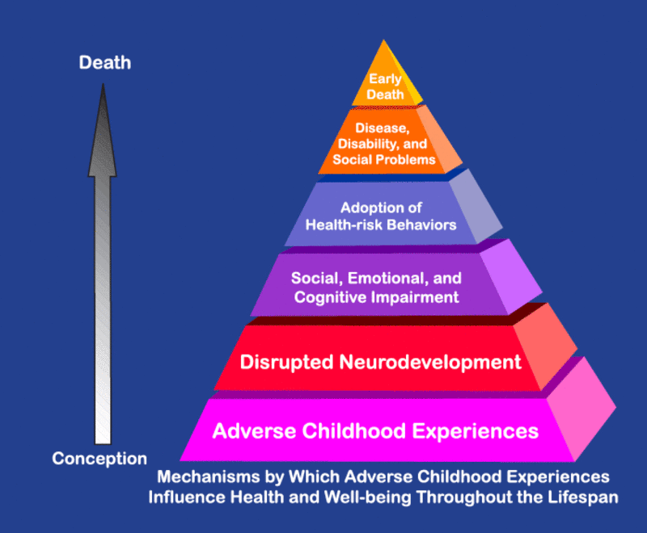
Notes:
Get Pictures of each of us…

Slide 35
MEASUREMENT OF ADVERSE CHILDHOOD EXPERIENCES
We measured the prevalence of eight adverse childhood experiences (ACEs), consisting of whether the child ever:
1. Lived with a parent or guardian who got divorced or separated
2. Lived with a parent or guardian who died
3. Lived with a parent or guardian who served time in jail or prison
4. Lived with anyone who was mentally ill or suicidal, or severely depressed for more than a couple of weeks
Notes:
35
Scott…

Slide 36
MEASUREMENT OF ADVERSE CHILDHOOD EXPERIENCES
5. Lived with anyone who had a problem with alcohol or drugs
6. Witnessed a parent, guardian, or other adult in the household behaving violently toward another (e.g., slapping, hitting, kicking, punching, or beating each other up)
7. Was ever the victim of violence or witnessed any violence in his or her neighborhood
8. Experienced economic hardship “somewhat often” or “very often” (i.e., the family found it hard to cover costs of food and housing).
Notes:
36
Scott…

Slide 37
Notes:
Get Pictures of each of us…

Slide 38
Tertiary Prevention:
Specialized
Individualized
Systems for Students with High-Risk Behavior
SCHOOL-WIDE
POSITIVE BEHAVIOR
SUPPORT
~5%
Secondary Prevention:
Specialized Group
Systems for Students with At-Risk Behavior
~15%
Primary Prevention:
School-/Classroom-
Wide Systems for
All Students,
Staff, & Settings
~80% of Students

Slide 39

Notes:
39
cody

Slide 40
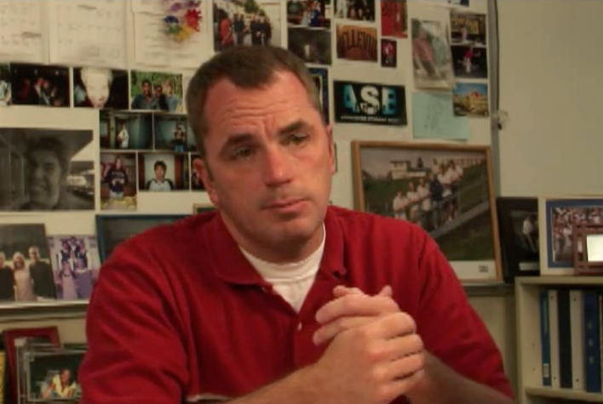
Repeat to Remember
40
Notes:
Scott

Slide 41
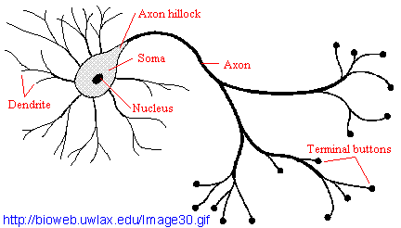
Brain Research
Neurons that fire together, wire together.

Slide 42
Human Calculator
Activity Directions:
This is played just like
rock-paper-scissors, but you are a calculator that can add.
Find a partner; on three, pick a number from 1 to 5 and do the calculation.
Follow directions.

Slide 43
Different Research Strands
40 Developmental Assets
Life Skills
Development
Social/ Emotional
Learning
Protective vs. Risk Factors
Notes:
40 Developmental Assets = Search Institute
Protective vs. Risk Factors = Prevention and Intervention (Drug & Alcohol Programs & Counceling)
CASEL & Social/ Emotional Learning Advocates = Life Skill Development

Slide 44
The Search Institute
40 Developmental
Assets

Slide 45
More Assets Equals Higher Success
Notes:
Scott

Slide 46
Fewer Assets Equals Lower Success
Notes:
scott

Slide 47
Average Number of Assets
25
21.5
19.8
20
17.8
17.4
16.9
16.9
17.2
18
Number of Assets
15
10
5
0
6
8
10
12
Grade Level

Slide 48
WASL Correlation
The more developmental Assets that can be built in young people, the more “Protective Factors” they have that lead to their overall success in school and in life.
    Michael Arthur, PHD University of WA in collaboration with OSPI
Notes:
cody

Slide 49
“At best, IQ contributes 20 % to the factors of success, which leaves 80% to Emotional Intelligence (EQ).”
Daniel Goleman
    (Emotional Intelligence)
Notes:
cody

Slide 50
Why Look at
Social/Emotional Learning?
Increased Commitment to School
Reduced Suspensions
Less Behavior Issues
More Time Devoted to Schoolwork
Improved Post-grad Employment Rates
Improved Graduation Rate
Increased Positive School Climate
Increased Mastery of Subject Material
Reduced Expulsions
(Hawkins et al., 1999; Malecki & Elliot, 2002)
Improved attendance
Notes:
cody

Slide 51
Life Skills for the Whole Child
Social
Skills
Emotional
Skills
Intellectual
Skills

Slide 52
Beach Ball
Activity Directions:
Orange - What did you learn?
Green - What excites you about the research?
Blue - What do you want to know more about?
White - How does this relate to your role as an educator?
Red - What will you do with this information?
Yellow - free choice

Slide 53
How to Build Successful Learning Communities
Notes:
53
cody

Slide 54
Gotcha!
Activity Directions:
Place your right hand, palm up.
Place your left index finger above your neighbor’s right hand.
When you hear the magic word,
  try to grab your neighbor’s finger
  without allowing yours to be grabbed.
Notes:
54
cody

Slide 55
Brain Research
Neurons that fire together, wire together.

Slide 56
Learning Community Model
Individual &
Group Success
Relationships, Relevance, & Rigor
Shared Memberships
Shared Purpose
Shared Norms
Shared Outcomes
Shared Skills
Experiences
Notes:
56
Scott

Slide 57
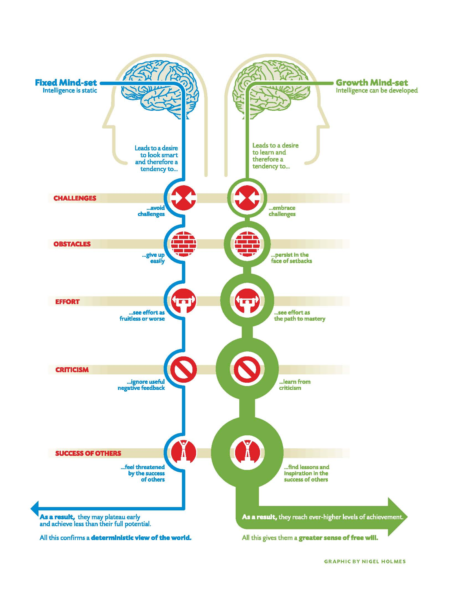
Mindsets
Notes:
57
Scott

Slide 58
“Learning is only possible after a student’s social, emotional, and physical needs have been met.”
Council on Adolescent Development
Notes:
scott

Slide 59
Maslow’s Hierarchy of Needs
Self-Actualization Needs
(Achieving individual potential)
Esteem Needs
(Self-esteem, Esteem from Others))
Love & Belonging Needs
(Love, Affection, Being a part of a Group)
Safety Needs
(Shelter, Removal from Danger)
Physiological Needs
(Health, Food, Sleep)

Slide 60
Panic Zone
Growth Zone
Comfort
Zone
“The willingness to take risks, ask questions and make mistakes is a requirement for learning.”
Deborah Meier (In Schools We Trust)
Notes:
Scott

Slide 61
The Method
Frame
Apply
Lesson
Reflect
5/24/2017

Slide 62
Brain Research
Neurons that fire together, wire together.

Slide 63

Schema
63
Notes:
Scott

Slide 64
The Method
Frame
Apply
Lesson
Reflect
5/24/2017

Slide 65
Reflection
“Experience in itself is neither productive nor unproductive, it is how you reflect on it that makes it significant or not significant.”
Gavin Bolton, 1979
    (Towards a Theory of Drama in Education)

Slide 66
Zoom
Notes:
66
Scott

Slide 67
Tools for
Building
Successful
Learning
Communities
Notes:
cody

Slide 68
Affirmations
I appreciate that you…
I enjoyed how you…
I liked it when…
Notes:
68

Slide 69
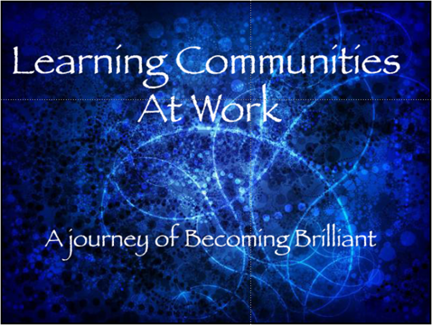
Movie Clip
Notes:
69
cody

Slide 70
Call a Friend
Activity Directions:

Slide 71
Feedback
In the future, you might consider…
Next time, perhaps you could…
This would be even better if…
It would help me learn if you …
Notes:
71

Slide 72

Class Movie
Notes:
72
Natalie

Slide 73
Talking Object
Activity Directions:
Use the object as the device
to let everyone know
whose turn it is to talk!

Slide 74
Think-Pair-Share
Consider:
What is a Learning Community?
How are Learning Communities
created?
Directions:
Think to yourself.
Discuss with a partner.
Share with your group.
74

Slide 75
Discussion Circles
Activity Directions:
The Person with the knot
will be the speaker –
Everyone else will practice
Active Listening.
2. Reflect and share:

Slide 76
Beach Ball
Activity Directions:
Orange- What did you learn?
Green- What excites you about the research?
Blue- What do you want to know more about?
White- How does this relate to your role as an educator?
Red- What will you do with this information?
Yellow- free choice

Slide 77
Quick Silly Game!
Also know as QSG
Activities used:
Human calculator
Gotcha!

Slide 78
Call a Friend
Activity Directions:

Slide 79
Roll of the Dice
A connection I made…
Something I’ll use...
I understand…
I’d like to know…
I’m excited about…
I have enjoyed…
Notes:
79
Curiosity, Communication, Be Present, Respect

Slide 80

Freedom Writers
Notes:
scott

Slide 81
Text a Friend
Activity Directions:
On an index card, briefly write
a text message to me answering:
Affirmation- Something you appreciate
Reflection- Something you learned
Feedback- Something we can improve
81
Notes:
natalie

Slide 82
Web Resources
http://extension.wsu.edu/4h/youth/4-h-adventure-education/
building-successful-learning-communities
Notes:
scott

Slide 83
Contact Information
WSU Extension
(253) 445-4581
Scott VanderWey vanderwey@wsu.edu
Notes:
scott

