Slide 1
Planning for Sustainable & Profitable Farms & Value-added Ag and Farm Businesses

Slide 2
Overview
8 Golden Questions
Business Plans 101
Branded Marketing
Direct to Consumer
Value-added
Your Business Plan + Your Farm Plan + Your Labor Plan + Your Timeline + Weather + Market Prices = ? (Wouldn’t You Like to Know?)
EDASC and the Ag & Food Economy of Skagit County

Slide 3
Picturing Your Dream Farm
1. Why do you want to start a farm?
2. What do you hope to gain for you and your family by starting a farm?
3. What type(s) of farm business do you want to start?

Slide 4
Marketing Your Products: Who and How?
4. How do you want to sell your products?
5. Who are your customers?

Slide 5
Growing Roots w/Your Farm & Family: Where & How
6. How will your farm business fit in with the rest of your life?
7. How ill you involve your family and friends in your farm business?
8. Where do you want your farm to be located?

Slide 6
Why Business Planning?
50% of all new businesses fail in first 5 years
Over lifetime of a business:
39% are profitable
30% breakeven
30% lose money
1% “unable to determine”
Business with fewer than 20 people:
37% chance of surviving 4 yrs
9% chance of surviving 10 yrs
Small scale farming is MORE difficult to be successful in than non-ag businesses
Business Planning Forces Farmers to…DO THE MATH!

Slide 7
Fuzzy Math: Farm Business Stats
94% of all U.S. farms are “small farms” = sales of < $250,000
74% of small farms with sales of < $50,000/year average a net cash farm income of NEGATIVE $1,702
These operations rely heavily on non-farm income to survive
20% of farms have sales btw $50,000-250,000/yr average net cash income of $23,159

Slide 8
Farm Strategy
Step 1: Gathering information and market research.
Step 2: Analyzing the external and internal components of your business using the S.W.O.T. analysis.
Step 3: Creating alternative plans of action and identifying areas of competitive advantage.
Step 4: Formulating a strategy is selecting the best plan that fits your overall farm mission.
Step 5: Implementing and evaluating the strategy.
Notes:
A Farm Strategy is an important component of a business plan. This strategy includes steps focused on market segments, attributes of those segments and forming a strategy around the needs of that segment. It is not easy, but it doesn’t have to be hard either.

Slide 9
Step 1: Gathering information and market research.
Market Research: Research your current and potential markets to identify trends, competitors, needs and buyers.
Focus groups, demographics, surveys, observation, interviews
Notes:
Never rely only on your opinion of what the market wants. Bullet #2 represents a number of tools to consider for your research. FOCUS GROUPS - a small group of potential consumers; DEMOGRAPHICS – US Census is a great resource; SURVEYS – consider an incentive to increase survey response rate; OBSERVATION – what are people buying, what are competitors offering: INTERVIEWS – other business owners and sales representatives may be able to provide information on what has or has not worked.

Slide 10
Step 2: Analyzing the external and internal components of your business using the S.W.O.T. analysis.
S.W.O.T. is an acronym for:
Strengths
Weaknesses
Opportunities
Threats
Notes:
Strengths and weaknesses are internal sections to the organization and provide insight into what components provide competitive advantages. Threats and opportunities are external to the farm and can not be changed, therefore the farm MUST change with and react to these factors.

Slide 11
Strengths and Weaknesses
Evaluation of the Internal Environment
Financial resources
Management capability
Human resources
Location
Facilities
Notes:
Areas of exploration of strengths and weaknesses include financial resources, management capability, human resource capability, age of equipment, available facilities, production process, land capability, location.

Slide 12
Threats and Opportunities
Evaluation of the External Environment
Competitor analysis
New/expanding markets
Regulations
Technology
economics
Notes:
Opportunities and threats include new markets, expanding markets, government regulations or incentives, new technology, increasing competition, lower or higher barriers to entry and economic conditions

Slide 13
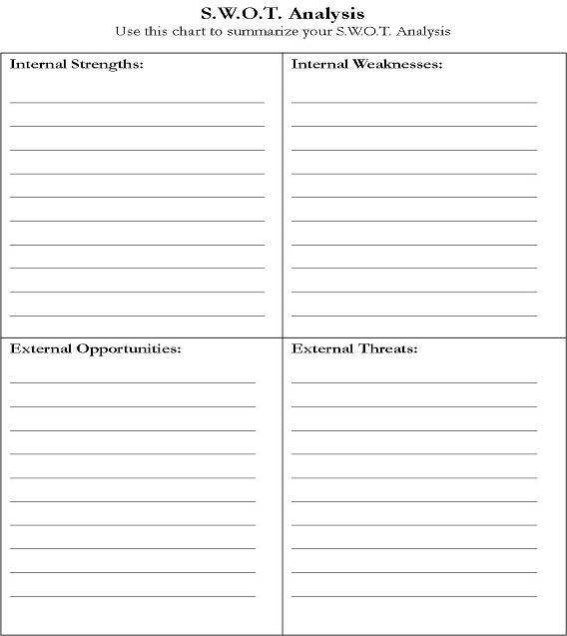

Slide 14
Step 3: Creating alternative plans of action and identifying areas of competitive advantage.
Pulling it all together – Internal Strengths with External Opportunities
Plan of Action
What is unique, what is your competitive advantage, what will your consumers value
Notes:
Compare and contrast the competitive advantages each strategy may offer and then select the best. This should be an ongoing creative process. If you find this phase difficult, break apart the process beginning with information discovery then focus on marketing strategy.

Slide 15
Step 4: Selecting the best plan that fits your overall farm mission.
It is now time to select the plan that best fits your overall farm operation
Keep in mind SWOT
Can you see yourself doing this in 5-10 years?
Include marketing, production, finances and management along with your competitive advantages.
Notes:
At this point you may want to come back and complete this after analyzing the marketing and financial.

Slide 16
Step 5: Implementing and evaluating the strategy
How are you going to get it done!
Following the financial plan there is a section that focuses on implementation

Slide 17
Business Plans/Planning
No matter how large or small it is necessary for you have a written farm business plan
Business plans help with
Is “THIS” what you really want
Values, goals, compatibility clarification
Supporting a loan application
Defining a new business, goals and steps to achieve those goals
Evaluating the effectiveness of business and marketing strategies
Set a direction for the business in the next five years
Growth and development for established businesses

Slide 18
Business Plans
A good business/marketing plan should be realistic, simple, specific and complete.
Is your plan realistic? Are your goals, dates and objectives realistic to your farm operation?
Is your plan simple? Can you and others read and understand the farm business plan?
Is your plan specific? Are goals, objectives and finances measurable?
Is your plan complete? Does your plan include all aspects of your farm business?

Slide 19
Contents of a Business Plan
Executive Summary
Mission and Goals
Background Information
Farm Strategy
Marketing Strategy and Plan
Enterprises Analysis and Plan
Financial Plan
Implementation Strategy
Human Resource Plan
Resource Inventory

Slide 20
Executive Summary
It is in the front of the document BUT the last task to be completed.
Overall summary of your business goals and objectives and how you plan to meet them.
Notes:
Write this when the workbook is finished.

Slide 21
Mission and Goals
Mission Statement: purpose of your farm operation (1 or 2 sentences)
Answer – Why does your business exist, what purpose and where are you headed.
Goals: Specific and measurable statements of what the business expects to achieve. Can include production, marketing, financial, etc…
Notes:
Think about WHO you are, WHY you are here, WHAT you do and WHERE are you headed? What is the farm’s purpose to the public, customers, employees, lenders and owners? A mission statement reveals more than the motive of profit – it should contain values, activities and the identity of the farm.
Goals are SMART: Specific, Measurable, Attainable, Rewarding, Timely (short term goals are one year or less, long term goals are one year or more)

Slide 22
Background Information
Description: Name, address, ownership, advisors, employees
History: A Summary of the history of the farm operation/business
Market/Customers (How you will make money)
Costs
Profit (How you will make money)
Operation Layout
Legal and Contractual Situation: Assets, contracts, insurance, estate plan, retirement, conservation programs, other
Production: Acreage, yields, livestock
Notes:
One page addressing: Where is the farm? How and when did it begin operation? How is it currently being operated? What is the general productivity, management and situation of the farm? What are general practices (conservation, environmental, tillage, marketing, risk, etc)?

Slide 23
Marketing Plan
Market research – Completed during the SWOT analysis
Target Market - It is important to understand who is purchasing your products so that your marketing efforts will reach that segment. You cannot be everything to everyone. In order to effectively market, you need to cater your product and services to the set of customers who will see value in the product you are offering. Who are you marketing to?
A target market can be developed by:
Demographics – age, gender, family size, education, occupation
Geographic – location, city, urban, rural
Psychographic – behavioral patterns, lifestyle similarities, common interests, beliefs and hobbies
Notes:
The marketing plan is much more than just the advertisement of your product, it is the entire plan of how to convey value, both real and perceived.
Identifying your target market enables you to appropriately market to them and your marketing efforts with be more effective.

Slide 24
Marketing Strategies
The 4 P’s of marketing
Product
Price
Place
Promotion

Slide 25
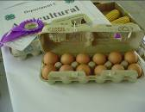
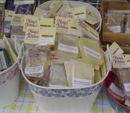
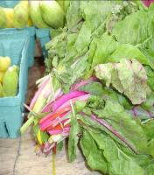
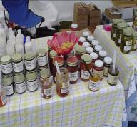
4 P’s of Marketing - PRODUCT
What sets your product apart from others? What are the products main attributes
Includes – Market research, logos, slogans, sizes and packaging
Physical/service
Features vs Benefits
Notes:
What are you REALLY selling? This includes the product or service, production, packaging, quality, even sizing, slogan and logo.

Slide 26
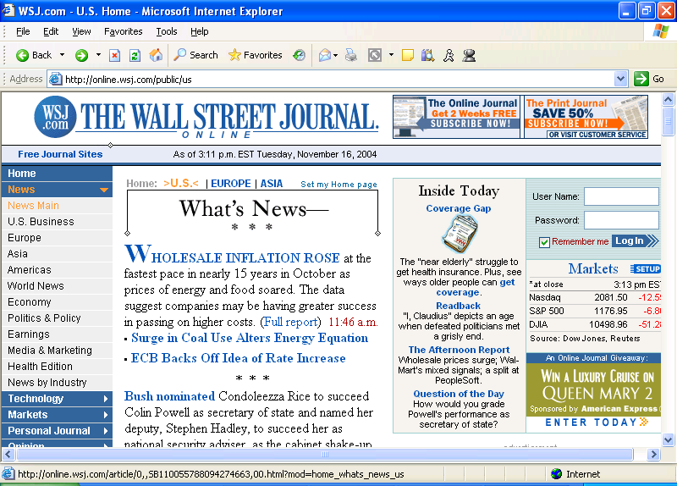
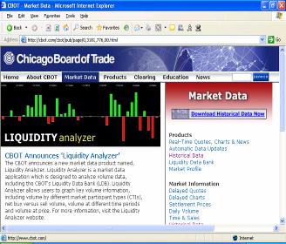
4 P’s of Marketing - PRICE
How much value does your product offer? How are you going to make pricing decisions?
Cost of production
Break even point
Market position
Re-price and evaluate
Perception
Location
Supply and competition
Notes:
To determine your price start with cost of production and break even price. If you are selling in a niche market your product may not be the lowest price, and it doesn’t need to be.

Slide 27
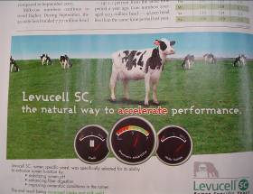
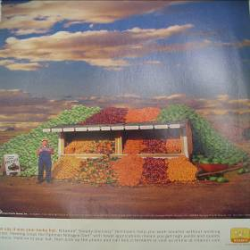
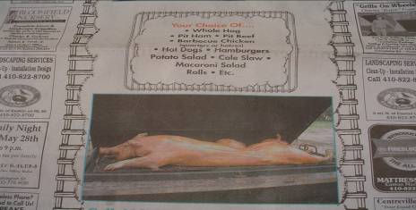
4 P’s of Marketing- PROMOTION
Where is the best value for your promotional money and efforts and how will you determine if they are working?
Unpaid – Positive, PR, newspaper
Paid – Advertising, publicity, sales promotions
Be creative!
Positive
Positive?
Notes:
Promotion of a product should be designed for your target market. Think creatively about how you promote your product.

Slide 28
Marketing Budget
Research
Communications
Networking
Promotions
Advertising
Public Relations
Distribution
Notes:
Costs related to the above, measuring quantity and cost. Research includes: hired sources, and publications purchased. Communications includes: promotional brochures, media, web design & maintenance. Networking includes: memberships & affiliations, events, subscriptions. Promotions includes: giveaways, discounts & special offers. Advertising includes: brochures (Development & production), logos/labels, packaging, signage, mailings, media & newspaper ads. PR includes: charity events, employee promotions, sponsorships and advertising. Distribution includes: shipping & transportation.

Slide 29
Enterprise Analysis and Plan
Divides costs and returns for each farm enterprise
Helps to determine the productivity of enterprises and if a farm should continue or change enterprises
Notes:
One farm may consist of many different enterprises, i.e. a retail produce market, hay sale, or petting zoo. Accurate recordkeeping of existing enterprises and detailed projections of planned enterprises is imperative.

Slide 30
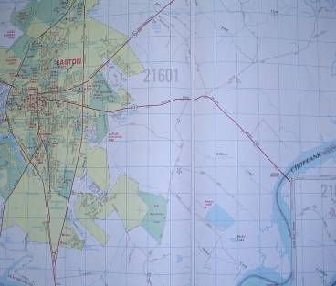
4 P’s of Marketing - PLACE
Where will you sell your product? Where does your target market shop?
Locations and logistics
Transportation and distribution
Notes:
The internet has provided a whole new opportunity in selling to a customer in another state, region even country; and delivering door to door.

Slide 31
Business Plan
Proper identification and written descriptions of a mission, goals and tactics for a meat goat enterprise will provide a strong foundation for the development of a complete business plan
A business plan provides a structure that guides the business planning and on-going business management process
Notes:
Address points on slide

Slide 32
Components of an Enterprise Budget
Gross Revenue: The total sales of product or services from the enterprise. Revenue can be calculated with the following formula: Price x Units Sold= Gross Revenue
Variable Cost: Cost items that vary with production volume. Examples of such items include fertilizer, seed, fuel, electricity, piece-work labor charges, pesticides, packaging cost, and custom charges.
Fixed Cost: Those cost that you will incur regardless of whether you produce any output. These costs are determined using the DIRTI 5 method which includes Depreciation, Interest, Repairs, Taxes, and Insurance. Often a piece of equipment or building will be used for more than one enterprise. In these cases it is important to estimate the percentage of use for each enterprise and allocate the cost accordingly.
Net Income: Net income is the money left after subtracting variable and fixed cost. This is the bottom line. NET INCOME = Gross Revenue – (Variable + Fixed Costs)

Slide 33
Financial Plan
Very important and necessary component of the business plan
Balance Sheet – Net Worth
Cash Flow – Liquidity
Income Statement – Profitability
Pro Forma Statements
Notes:
Financial statements help you determine your farms net worth, liquidity & profitability; make important production, financing & investment decisions; help with credit & lending applications; develop budgets for each farm enterprise. BALANCE SHEET – a detailed listing of assets, liabilities & net worth at a given point in time. Net worth is the best measure of a farm’s financial position. CASH FLOW – liquidity only includes cash income or expenses therefore determines the ability of your farm to generate enough cash to meet financial obligations without disrupting the normal operation of the farm. INCOME STATEMENT – profitability is the summary listing of income, expense and, ultimate, profit of the farm in a calendar year.

Slide 34
Balance Sheet
Summarizes Assets, Liabilities (Debt), Net Worth
Net Worth = Value of Assets – Value of Liabilities
Current (< 12 months), Intermediate (1-10 years) Long Term (>10 years), Non-farm
“A Balance Sheet is a snapshot of the farm’s financial position”
Notes:
Net worth is sometimes referred to as owner’s equity.

Slide 35
Cash Flow
Summarizes all cash in-flows and out-flows for a period of time
Checkbook Accounting
In-Flows – crops & livestock sales, receipts, sale of capital assets, borrowed money
Out-Flows – production, capital expenditures, loan payments, living expenses
Important on farms because of seasonality
Projected and Actual Cash Flow
Notes:
Projected cash flow estimates the expected cash inflows and outflows during a specific accounting period. Actual cash flow is the actual inflows and outflows incurred and the two are compared. Use the ending year’s actual cash flow statement to establish the coming year’s projected cash flow statement

Slide 36
Income Statement
Summary of revenues and expenses for a specific time period
Revenue – Receipts from sales, government payments, dividends
Expenses – Production expenses, interest, taxes, insurance, loans
Inventory Changes – Accrual adjustment
Depreciation and Capital Adjustments
Revenue – Expenses = Net Income
Main purpose is to determine how much income was generated by the farm operation
Notes:
Income statements are prepared by using either the cash or accrual accounting methods. The accrual method ultimately gives a more accurate picture of farm profit.

Slide 37
Projected Financial Statements
Lender, farm operation or other factors may require projected financial statements
To do this review enterprise budgets and financial statements
Notes:
Being conservative and realistic in your projections will help your business in the long run.

Slide 38
Implementation Strategy
Research completed, finances in order
Time to implement
Production
Management
Marketing
Human resources
Finance and accounting
Notes:
The implementation plan includes a timeline, your ultimate “To-Do List”

Slide 39
Enterprise Analysis and Plan
Divides costs and returns for each farm enterprise
Helps to determine the productivity of enterprises and if a farm should continue or change enterprises
Notes:
One farm may consist of many different enterprises, i.e. a retail produce market, hay sale, or petting zoo. Accurate recordkeeping of existing enterprises and detailed projections of planned enterprises is imperative.

Slide 40
Business Plan Format
Overall description of the business
Management overview
Description of the products planned to market
Market analysis and development of marketing strategies
Financial plan
Tax returns, legal documents, contracts and agreements
Notes:
Address points on slide and add: An example business plan format is found on page 5.

Slide 41
Obtaining Financing
Insufficient planning and lack of capital are the most frequently cited reasons that businesses fail
Whether you are starting or expanding a goat enterprise, sufficient capital is essential
But knowledge and planning are required to manage capital well
Significant start-up costs can make the early days (and years) of a new enterprise stressful
Notes:
Address points on slide

Slide 42
Funding the Enterprise
Comes from either one or a combination of two primary sources
Equity
Debt
Notes:
Address points on slide

Slide 43
Equity
The owner’s contribution to the start up of the enterprise
Money that stays in the business and does not have a definite repayment schedule
Critical component of an enterprise that is in need of additional funds
Notes:
Address points on slide

Slide 44
Debt
Debt funding (or a loan) is critical for enterprises that do not have sufficient equity to finance the business needs
Loans are generally set-up with a fixed payment schedule
Lenders may require that equity represent 25 to 50 percent of the total start-up costs for a new business
Notes:
Address points on slide

Slide 45
Loans
Generally obtained from commercial banks, government agencies or some other third party that sets a specific repayment schedule
Secured or non-secured
Non-secured loans are based entirely on the borrower’s financial strength and past performance
Secured loans require that assets be used as collateral to secure the loan
Notes:
Address points on slide

Slide 46
Developing Farm Plans
An outline of the proposed operation of the farm business
Indicates what to produce, how much to produce and how to produce it
Two types of farm plans
Long-run plan
Short-run plan
Notes:
We have previously addressed the need for records. Managers can put those records to good use when developing farm plans. Address points on slide

Slide 47
Long-run Plans
Estimate of the resource allocation that is likely to yield greatest net returns over a period of years
Based on family goals
Shows the changes in farm business organization that must take place to attain those goals
Revise if technology or input or output prices change materially
Notes:
A long-run plan attempts to find the best way to utilize the resources on a particular farm. All farms are different. There is no cookie cutter plan that work for all farms. Long-run plans seek to find the combination of enterprises that will yield the greatest net return over a period of years. Long-run plans should be based on the family’s goals and must be revised if technology or prices change significantly.

Slide 48
Short-run (Annual) Plans
Made to fit the individual year
Implements the transition from the present farming system to the proposed long-run plan
Notes:
Short-run or annual plans are developed for an individual year. Annual plans can help implement the changes that are needed to implement the long-run plan.

Slide 49
Intensive Planning
Long-run and short-run farm plans must be flexible if they are to be realistic and serve the purpose for which they are intended
Helps producers understand their financial situation and make informed decisions
Notes:
Long-run and short-run farm plans must be flexible if they are to be realistic and serve the purpose for which they are intended. UT Extension’s MANAGE Program assists farm families in developing these intensive farm plans using the FINPACK Computer Farm Analysis package. Intensive planning helps producers understand their financial situation and make informed decisions.

Slide 50
Addresses Major Financial Objectives
Profitability – ability to generate net income
Liquidity – provide cash when needed
Solvency – financial growth and security
Notes:
Intensive planning addresses these major financial objectives: Address points on slide

Slide 51
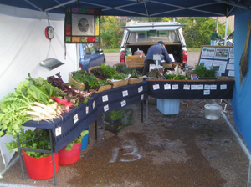
“Farm for profit, not production”
Plan all activities around net/gross ratio
Farm 1: $50,000 - $45,000 = $5,000: 10%
Farm 2: $10,000 - $5,000 = $5,000: 50%
Who can expand/meet goals more easily?
Net goal $30,000:
Farm 1 needs $300,000 gross
Farm 2 needs $60,000 gross
Plan for long-term needs
Efficiency matters; the less you
spend, the less you have to earn

Slide 52
Intensive Planning Tools
Long-range Planning - compares alternative farm plans
Cash Flow Planning - projects farm cash flows monthly or annually for up to ten years
Year-End Analysis - analyzes financial performance of a farm business in the past year; generates a historical data base
Notes:
Long-range Planning compares alternative farm plans which may involve new enterprises, new resources, different sizes or combinations of current enterprises, changes in efficiency or changes in debt structure. Long-range planning enables you to easily investigate the feasibility of a change before it is implemented. Cash Flow Planning projects farm cash flows monthly or annually. You can use cash flow planning to project annual operating loan needs and the timing of borrowing and repayment during the year. Year-End Analysis analyzes financial performance of a farm business in the past year and can generate a historical data base to show progress toward objectives.

Slide 53
Enterprise Budgets
Estimate of projected income and expenses associated with the production of a commodity
Analyze the effects of changes within the operation
Determine which commodity is contributing to profitability and which commodity is losing money
Notes:
Enterprise budgets are a major component of planning. Enterprise budgets estimate income and expenses associated with a particular commodity and thus allow the producer to determine which enterprises are profitable and which are not.

Slide 54
Enterprise Budgets
Usually based on some production unit/one acre of a specific crop
Either historical or projected
Historical enterprise budgets are created using actual income and expense information
Projected enterprise budgets attempt to estimate income and expenses in the future
Notes:
Address points on slide

Slide 55
Enterprise Budgets
If the budget is for a new enterprise, research on expected income and expenses should be the basis of the budget
Estimates of changing costs or income should be conservative
Notes:
Address points on slide plus: Enterprise budgets based on past production history are usually more accurate.

Slide 56
Variable Costs (Expenses)
Directly tied to the enterprise and can be changed in the short-run
Feed
Health
Marketing
Fertilizer
Shown as per unit rate
Notes:
The discussion of costs related to enterprise budgets is usually divided into variable costs and fixed costs. Variable costs are directly tied to the production of the enterprise and can be changed in the short-run. Variable costs are incurred only of the enterprise is produced. If you decide not to produce goats, you have no cost for feed. If you do not grow the crop, you do not buy fertilizer.

Slide 57
Fixed Costs (Expenses)
Committed to pay regardless of whether livestock is raised during the current planning period
Depreciation and insurance on machinery, equipment and buildings
Interest on machinery, equipment, buildings and land
Property taxes
Notes:
On the other hand, fixed costs must be paid regardless if you produce goats or another enterprise. Fixed costs include depreciation, insurance, interest and taxes.

Slide 58
Recovering Costs
Both fixed and variable costs are considered when deciding whether to continue production
In the short run, the producer should stay in production if it appears that revenue will at least cover variable costs
All costs must be recovered over time
Notes:
Address points on slide

Slide 59
Interest Expenses
Reflect the fact that capital invested is costly, regardless of its source
Borrowed capital entails a cash interest charge for repayment to lenders
Capital provided by the owner results in a non-cash opportunity cost
Capital could have been invested elsewhere and earned interest
Notes:
Interest expenses are included in this budget even though a producer may not borrow the funds need to invest in the goat enterprise. Address points on slide

Slide 60
Labor Expenses
Reflect the cost of hired and/or owner labor
Owner provided labor is a non-cash opportunity cost for earnings foregone if time spent on another paying job or enterprise
Hired labor is cash expense
Notes:
Some producers may not see the need to include labor in the budget if the producer is doing all the work. But that time has value. If the producer was not producing goats that time could be spent on other endeavors. Including labor helps to compare enterprises that may require different amounts of time to complete.

Slide 61
Time management
- Always consider the value of your time
- Ask “What’s in it for me?”
- Assess relative uses of time
- Going to market takes two days; will I make enough to justify that?
- 2 ten-hour days: 20hr x $8 = $160
- Plan around core principles

Slide 62
Human Resource Plan
The people part of your plan
Does not matter how large or small your business
Parts of the Human Resource Plan
Position and duties
Organizational chart
Skills and training
Notes:
In addition to job responsibilities and assignments a human resource plan identifies the legal and liability issues involved with having employees. You must review Maryland’s employee laws and what may apply to your business.

Slide 63
Skills and Training
Continuing education and advancement in technology is very important
Includes
Skill Needed
Training available
Who in the farm business is responsible

Slide 64
Business plans are dynamic
- Continually assess, revise, and adapt as needed
- Deeply tied to individual circumstances
- Conditions on the ground
- Skills and interests of the farmer
- Resources available
- Every farm should have a different focus, resulting in an effective whole

Slide 65
Exit Strategy
Agriculture includes many risks. These should be considered
What are your exit signals
Farm profit
Set age
Estate plans and farm/business transfer
Change of markets
Property value
Notes:
The exit strategy should include this set of criteria that SIGNAL to you that it’s time to consider exiting the business.

Slide 66
SWOT
Strengths: Fertile soil - Quality product Ideal location - I-5 Corridor Helping the farming community - a moral mission Support from cutting edge research | Weaknesses: Skagit Valley lacks a unifying identity Lack of year-around attraction An economically deflated area
Opportunities: Unifying around a common brand Establish a model to sustain the farming community Prime real estate available for Market Creating a hub of economic opportunity | Threats: Long-term plan(s) of existing farmers Competition from established local entities (Co-Op, Burlington, etc.) Local community, if they see lack of value Outside entities seeking farming land
Notes:
The team conducted a SWOT analysis to bring forward the Strengths, Weaknesses, Opportunities and Threats in the Skagit Valley.
Along with major strengths, Skagit Valley also has quite a few weaknesses and threats that the marketing plan will need to address. Appropriate strategies can be used to capitalize on the the strengths and opportunities and minimize the effect of the weaknesses and threats.
Major Strategies focus on:
Utilizing strengths such as ideal location, fertile soil, quality produce & support from research extension and develop a business plan that shows opportunity in the farming business thus addressing the threat of possible farmer defection.
Using a clear future vision that creates a unifying identity where the entire Valley can come together and work towards a common cause.

Slide 67
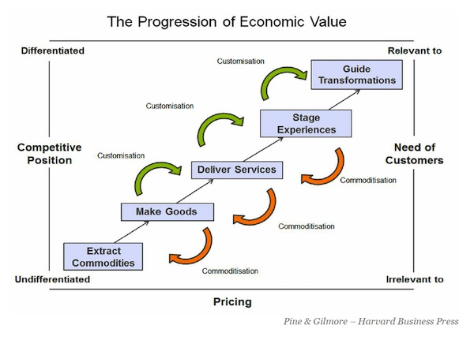

Slide 68
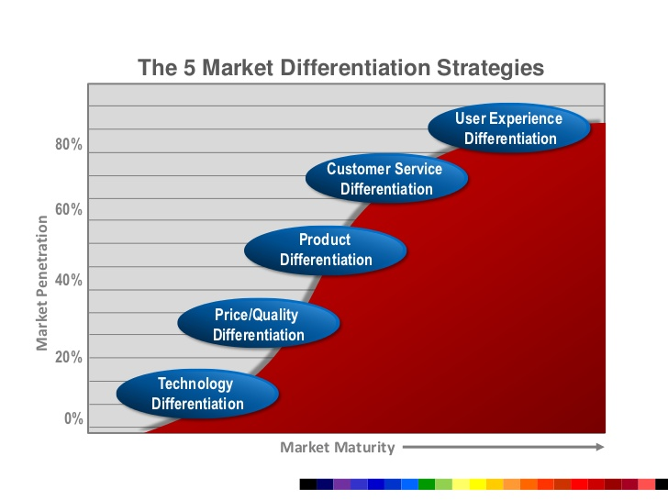

Slide 69
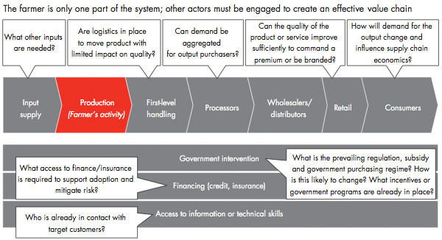

Slide 71
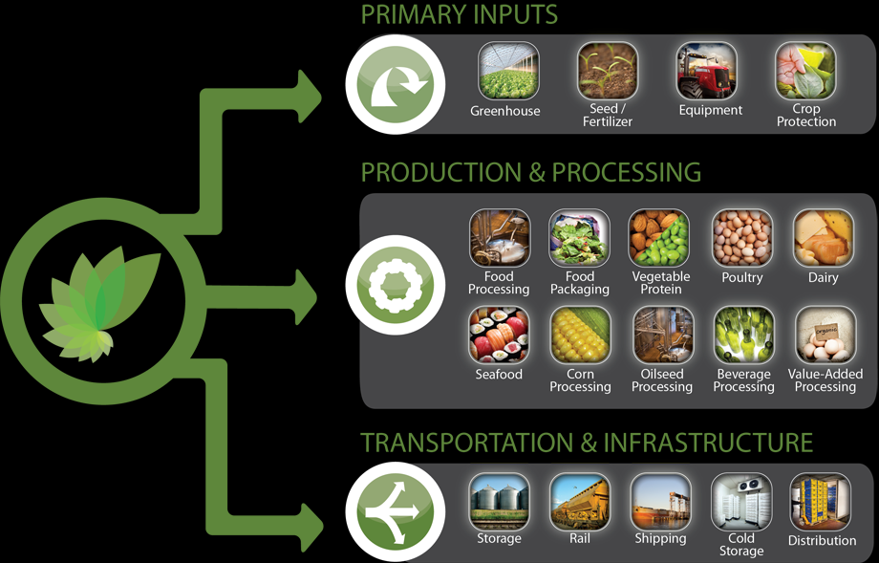
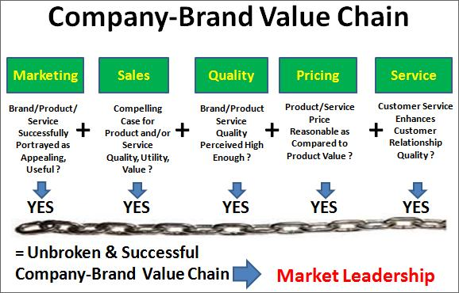

Slide 72
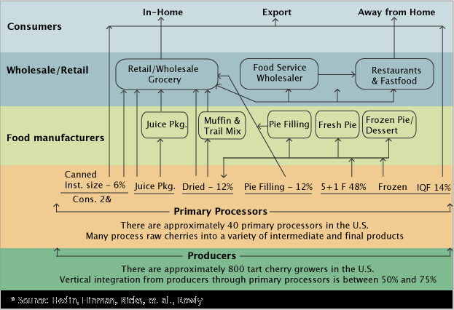

Slide 73
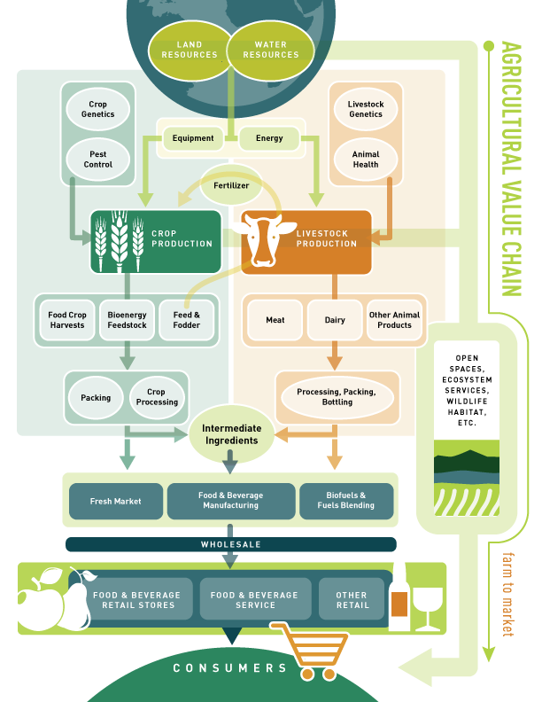

Slide 74
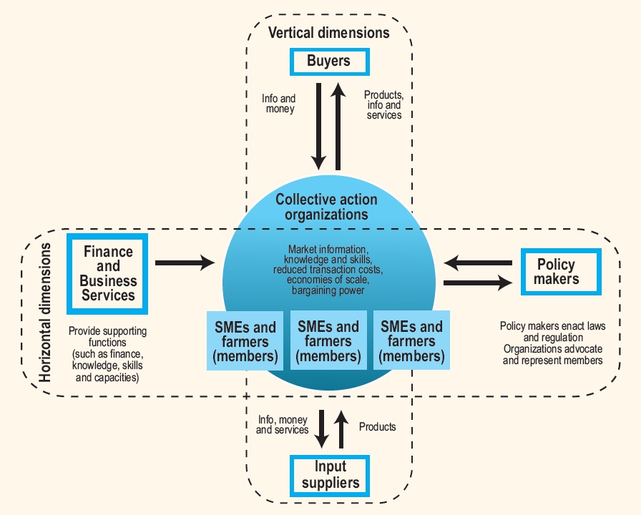

Slide 75
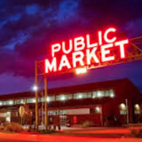
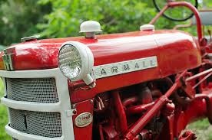
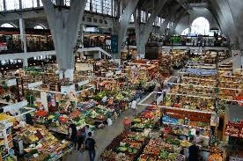
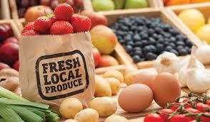
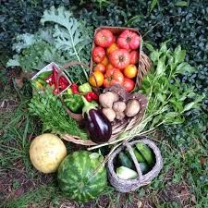
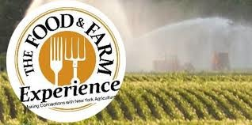

Slide 76
Thank You

